Slide 1

SOLID JS

Slide 2
What is Solid JS?
Solid.js is a JavaScript library for building user interfaces, and it is
designed to be highly efficient and performant. It falls into the
category of modern front-end frameworks like React,
Vue, and Angular.
It is a JavaScript framework that supports binding data to elements
that it then syncs and displays on web pages.
It was developed by Ryan Carniato and released in 2020.

Slide 3
Features of Solid JS?
Reactivity: Solid.js leverages a fine-grained reactivity system, which means that it only updates the parts of the DOM (Document Object Model) that have actually changed. This can lead to significant performance improvements, especially in complex and large-scale applications.
Component-based: Like React and other modern UI libraries, Solid.js uses a component-based architecture. You can create reusable components that encapsulate both the structure and behavior of a portion of the user interface.
JavaScript/JSX: Solid.js uses JavaScript and JSX (JavaScript XML) to define components, making it easy to understand and work with if you're already familiar with these technologies.
Efficiency: Solid.js is known for its efficient rendering and update process. It aims to minimize re-renders and ensure that updates are as performant as possible.
Small bundle size: The library is designed to have a small bundle size, making it suitable for applications where size matters, such as mobile apps or websites.
Server-side rendering: Solid.js supports server-side rendering (SSR), which can be beneficial for improving initial page load times and search engine optimization (SEO).
Hooks system: Similar to React, Solid.js provides a hooks system that allows you to manage component state and side effects in a more organized and reusable way.
Adoptability: Solid.js is designed to be easy to pick up if you have experience with React or similar frameworks. It also integrates well with existing JavaScript and TypeScript projects.

Slide 4
What is Signal in Solid?
In Solid.js, a "signal" is a core concept used for creating and managing reactive data dependencies. Signals are a fundamental part of the Solid.js reactivity system and play a role similar to that of reactive variables or computed properties in other reactive frameworks, such as Vue.js or Svelte.

Slide 5
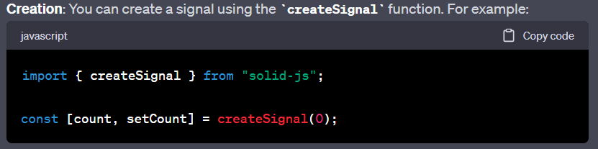
Creation: We can create a signal using CreateSignal function

Slide 6
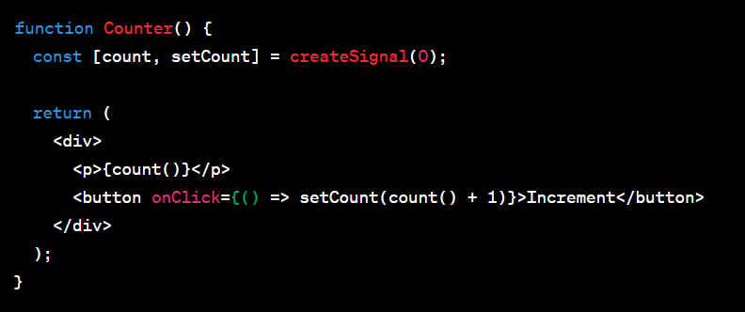
Usage in Components: You can use signals in your components to access and render data. When a signal's value changes, Solid.js will automatically re-render the component to reflect the new data.

Slide 7
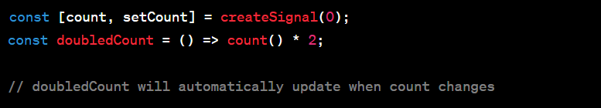
Derived Signals: You can derive new signals from existing ones. This is useful for creating computed properties or transforming data. When the parent signal changes, the derived signals automatically update as well.

Slide 8

Solid vs React

Slide 9
Reactivity and Performance:
Solid.js: Solid.js is known for its fine-grained reactivity system, which updates only the parts of the DOM that have changed. This can lead to very efficient and performant updates, making it suitable for high-performance applications.
React: React uses a virtual DOM to optimize updates and minimize direct manipulation of the actual DOM, which also results in efficient rendering. However, Solid.js's reactivity system is often considered even more fine-grained and performant.
2. Learning Curve:
Solid.js: Solid.js has a simpler and more intuitive API, which some developers find easier to learn and work with, especially if they are new to modern frontend development.
React: React, while more complex to get started with, has a larger community and more extensive resources, making it easier to find help, libraries, and solutions to common problems.
3. Ecosystem and Libraries:
Solid.js: Solid.js has a smaller ecosystem and fewer third-party libraries and components compared to React. However, it can interoperate with existing JavaScript and React codebases, allowing you to leverage the broader React ecosystem if needed.
4. Component Model:
Solid.js: Solid.js uses a hooks-based component model similar to React, making it easy to manage component state and side effects.
React: React introduced hooks in version 16.8, which significantly improved component state management.

Slide 10
5. Community and Adoption:
Solid.js: Solid.js is a newer library, so it has a smaller community and adoption compared to React. However, it has been gaining traction and could continue to grow over time.
6. Server-side Rendering (SSR):
Solid.js: Solid.js has built-in support for server-side rendering, which can be important for SEO and initial load performance.
React: React also supports SSR, but the implementation may require additional setup and configuration.
7. TypeScript Support:
Both Solid.js and React have good support for TypeScript, making it easier to write type-safe code.
8. Size:
Solid.js is designed to have a smaller bundle size compared to React, which can be beneficial for applications where size is a concern.
9. Integration:
Solid.js can be integrated with React and other libraries, which means you can use it alongside existing codebases.

Slide 11
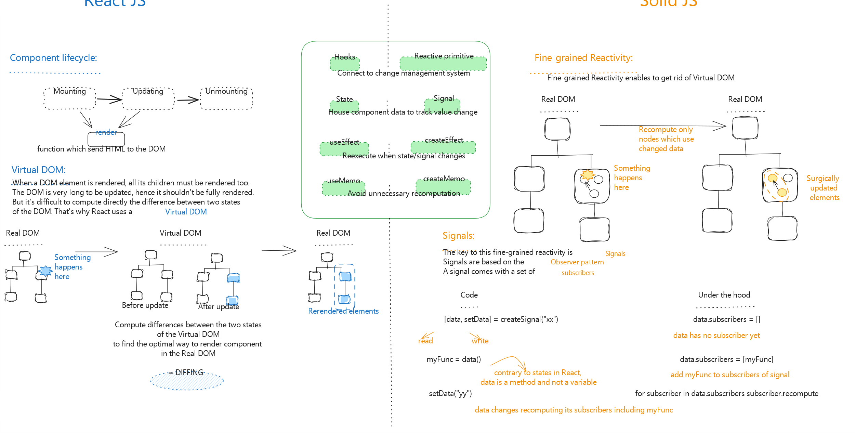
REACT SOLID

Slide 12
Solid or React
Which one should we use?

Slide 13
Use Solid.js when:
Performance is critical: Solid.js is known for its performance optimizations. It uses a fine-grained reactivity system and compiles templates to highly efficient JavaScript code. If you're building applications with a strong focus on speed and efficiency, Solid.js might be a good choice.
Smaller bundle size: Solid.js tends to produce smaller bundle sizes compared to React. This can be beneficial for improving the loading times of your web applications, particularly in low-bandwidth or mobile environments.
Minimal re-renders: Solid.js minimizes unnecessary re-renders by updating only the parts of the UI that have actually changed. This can lead to more efficient rendering and better overall performance.
Familiarity with Svelte or Vue: If you're already familiar with Svelte or Vue, you might find Solid.js easier to pick up, as it shares some concepts with these frameworks.
Simplicity: Solid.js has a relatively small API surface and straightforward concepts, making it a good choice for developers who prefer simplicity and minimalism.

Slide 14
Use React.js when:
Ecosystem and community: React has a vast ecosystem, a large and active community, and a wide range of third-party libraries and components. If you need extensive third-party support, documentation, and resources, React is a strong choice.
Team familiarity: If your team has prior experience with React, it can be more efficient to stick with it, as there's a lower learning curve for your team members.
Rich and complex UI: React is a solid choice for building complex and highly dynamic user interfaces. Its component-based architecture and state management options, like Redux or Mobx, make it a flexible tool for such scenarios.
Frequent updates: React has a history of consistent updates and improvements, which can be beneficial if you need to stay up to date with the latest features and best practices.
Native mobile app development: If you plan to build native mobile applications alongside web applications, React Native is a powerful framework for this purpose. Solid.js does not have an equivalent mobile development framework.

Slide 15
In the end, the choice between Solid.js and React.js should depend on your specific project requirements and your team's familiarity with the technology. You can also consider factors like performance, bundle size, and your personal development preferences when making your decision. Additionally, you can always experiment with both frameworks to see which one aligns better with your project's needs.

Slide 16

What is Vite?
Vite is an open-source build tool and development server for web applications. It is designed to streamline the development process by providing fast and efficient development and production workflows. Vite is primarily used for building modern web applications, particularly those using JavaScript frameworks like Vue.js, React, Solid and Svelte.

Slide 17
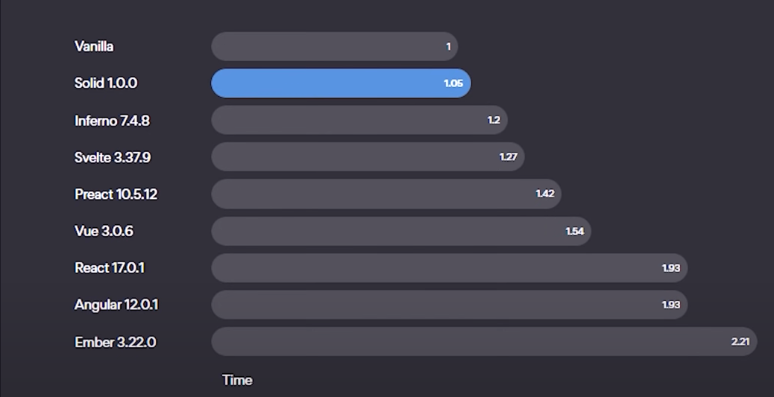
Compilation Time

Slide 18
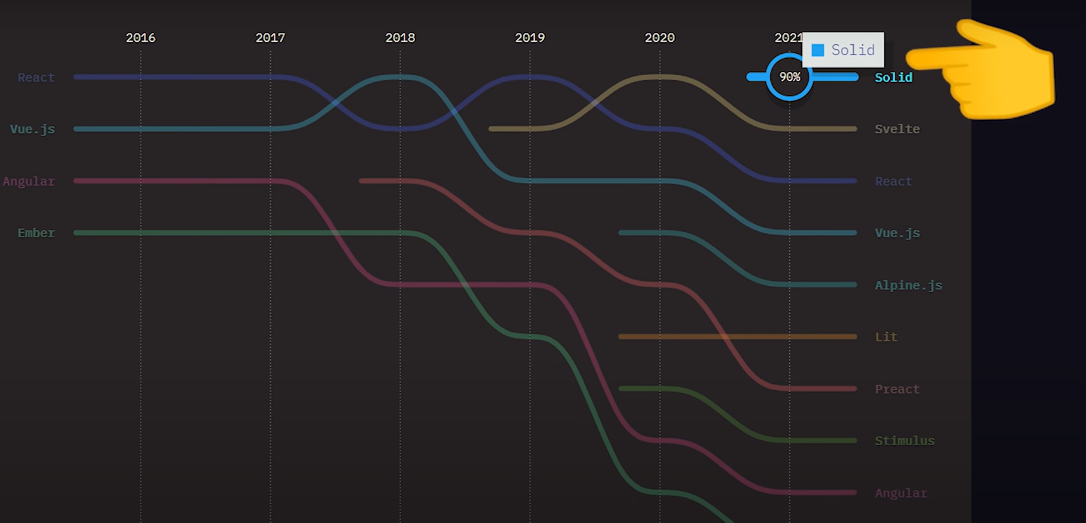
Trending in Industry

Slide 19
For more , please refer to the following website
https://www.solidjs.com

