Slide 1

NEXT.JS
The React Framework for The Web
Next.js enables you to create full-stack Web applications by extending the latest React features and integrating
powerful Rust-based JavaScript tooling for the fastest builds
Ref: https://nextjs.org/
www.arkilos.com | enquiries@arkilos.com
Arkilos Inc. 2022 © All Rights Reserved

Slide 2
What's in Next.js?
All the tools you need to make the Web. Faster
Build-In Optimizations
Automatic Image,Font and Script Optimizations for improved UX and Core Web Vitals.
React ServerComponents
Server-first,Layouts and Streaming with an intuitive file-system router.
Client And Server Rendering
Flexible rendering and caching options,including Incremental Static
Regeneration (ISR),on a per-page level.
Data Fetching
Data Fetching methods that run on the server and enable you to render conent in different ways.
CSS Support
CSS Modules, Sass, PostCss, and Css-in-Js.
www.arkilos.com | enquiries@arkilos.com
Arkilos Inc. 2022 © All Rights Reserved

Slide 3
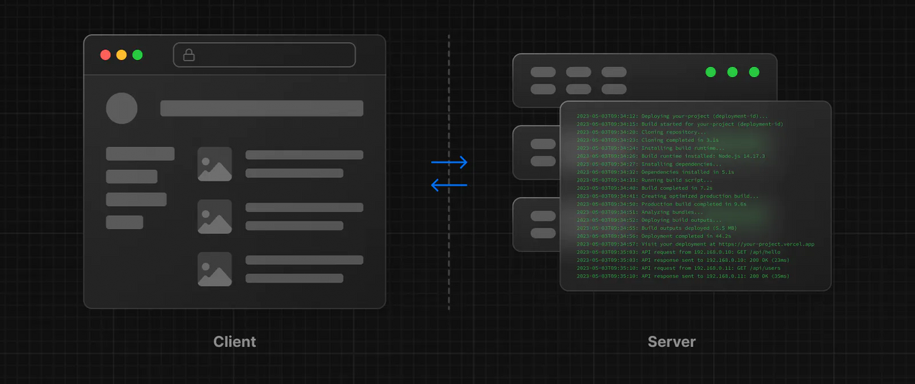
Rendering
There are two environments where your application code can be rendered: the client and the server.
CSR (Client Side Rendering)
SSR (Server Side Rendering)
www.arkilos.com | enquiries@arkilos.com
Arkilos Inc. 2022 © All Rights Reserved

Slide 4
Installation
Terminal
npx create-next-app@latest
On installation, you'll see the following prompts:
What is your project named? my-app
Would you like to use TypeScript with this project? No / Yes Would you like to use ESLint with this project? No / Yes Would you like to use Tailwind CSS with this project? No / Yes
Would you like to use `src/` directory with this project? No / Yes Use App Router (recommended)? No / Yes
Would you like to customize the default import alias? No / Yes
www.arkilos.com | enquiries@arkilos.com
Arkilos Inc. 2022 © All Rights Reserved

Slide 5
Client-Side Rendering
The CSR process is as follows:
The user enters the URL they wish to visit in the address bar. A data request is sent to the server at the specified URL.
On the client’s first request for the site, the server delivers the static files (CSS and HTML) to the client’s browser.
The client browser will download the HTML content first, followed by JavaScript. These HTML files connect the JavaScript, starting the loading process by displaying loading symbols the developer defines to the user. At this stage, the website is still not visible to the user.
After the JavaScript is downloaded, content is dynamically generated on the client’s browser.
The web content becomes visible as the client navigates and interacts with the website.
www.arkilos.com | enquiries@arkilos.com
Arkilos Inc. 2022 © All Rights Reserved

Slide 6
Server-Side Rendering
Server-side rendering is the more common technique for displaying information on a screen.
The web browser submits a request for information from the server, fetching user-specific data to populate and sending a fully rendered HTML page to the client. Every time the user visits a new page on the site, the server will repeat the entire process.
Here’s how the SSR process goes step-by-step:
The user enters the URL they wish to visit in the address bar.
The server serves a ready-to-be-rendered HTML response to the browser. The browser renders the page (now viewable) and downloads JavaScript.
The browser executes React, thus making the page interactable.
www.arkilos.com | enquiries@arkilos.com
Arkilos Inc. 2022 © All Rights Reserved

Slide 7

www.arkilos.com | enquiries@arkilos.com
Arkilos Inc. 2022 © All Rights Reserved

