Slide 1

PWA
Progressive Web Applications
Ref: google
www.arkilos.com | enquiries@arkilos.com
Arkilos Inc. 2022 © All Rights Reserved

Slide 2
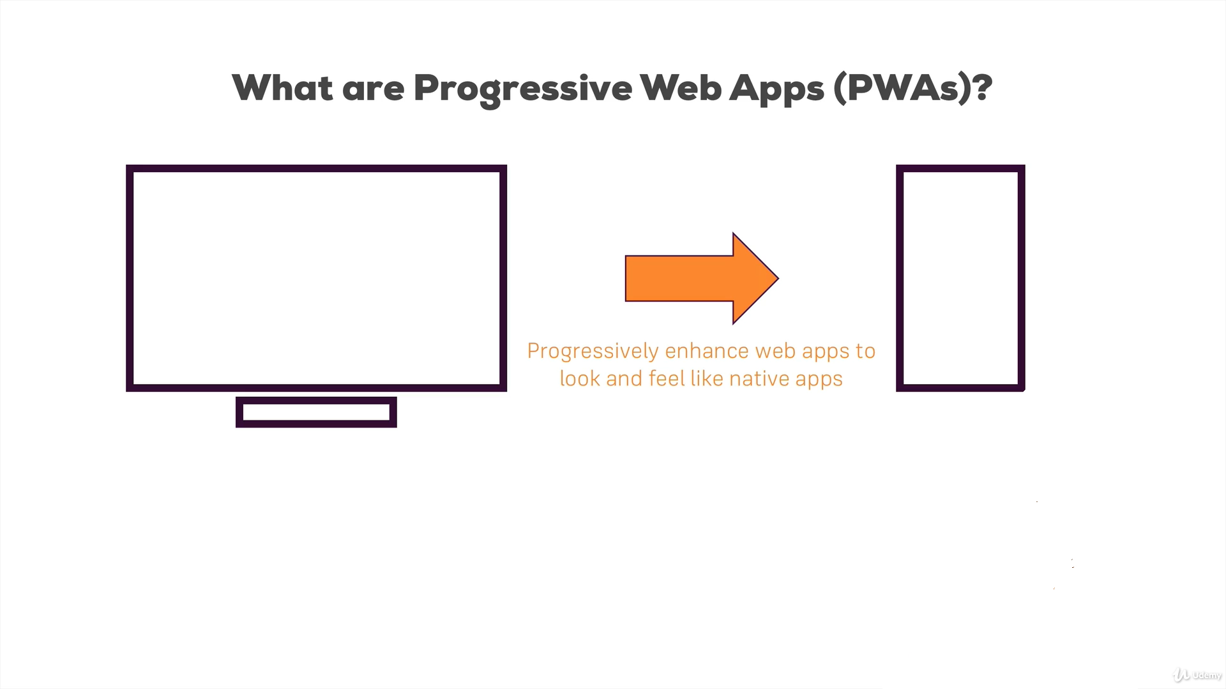
www.arkilos.com | enquiries@arkilos.com
Arkilos Inc. 2022 © All Rights Reserved

Slide 3
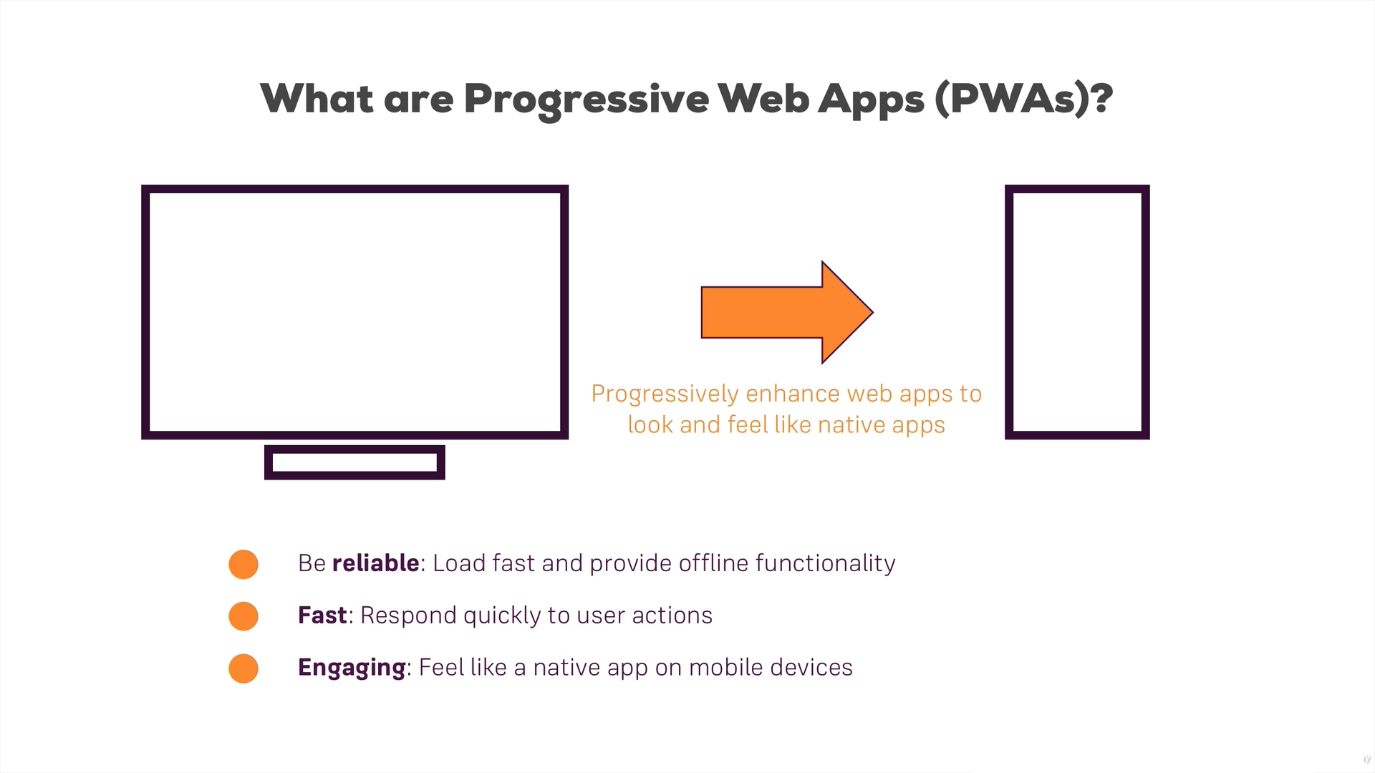
www.arkilos.com | enquiries@arkilos.com
Arkilos Inc. 2022 © All Rights Reserved

Slide 4
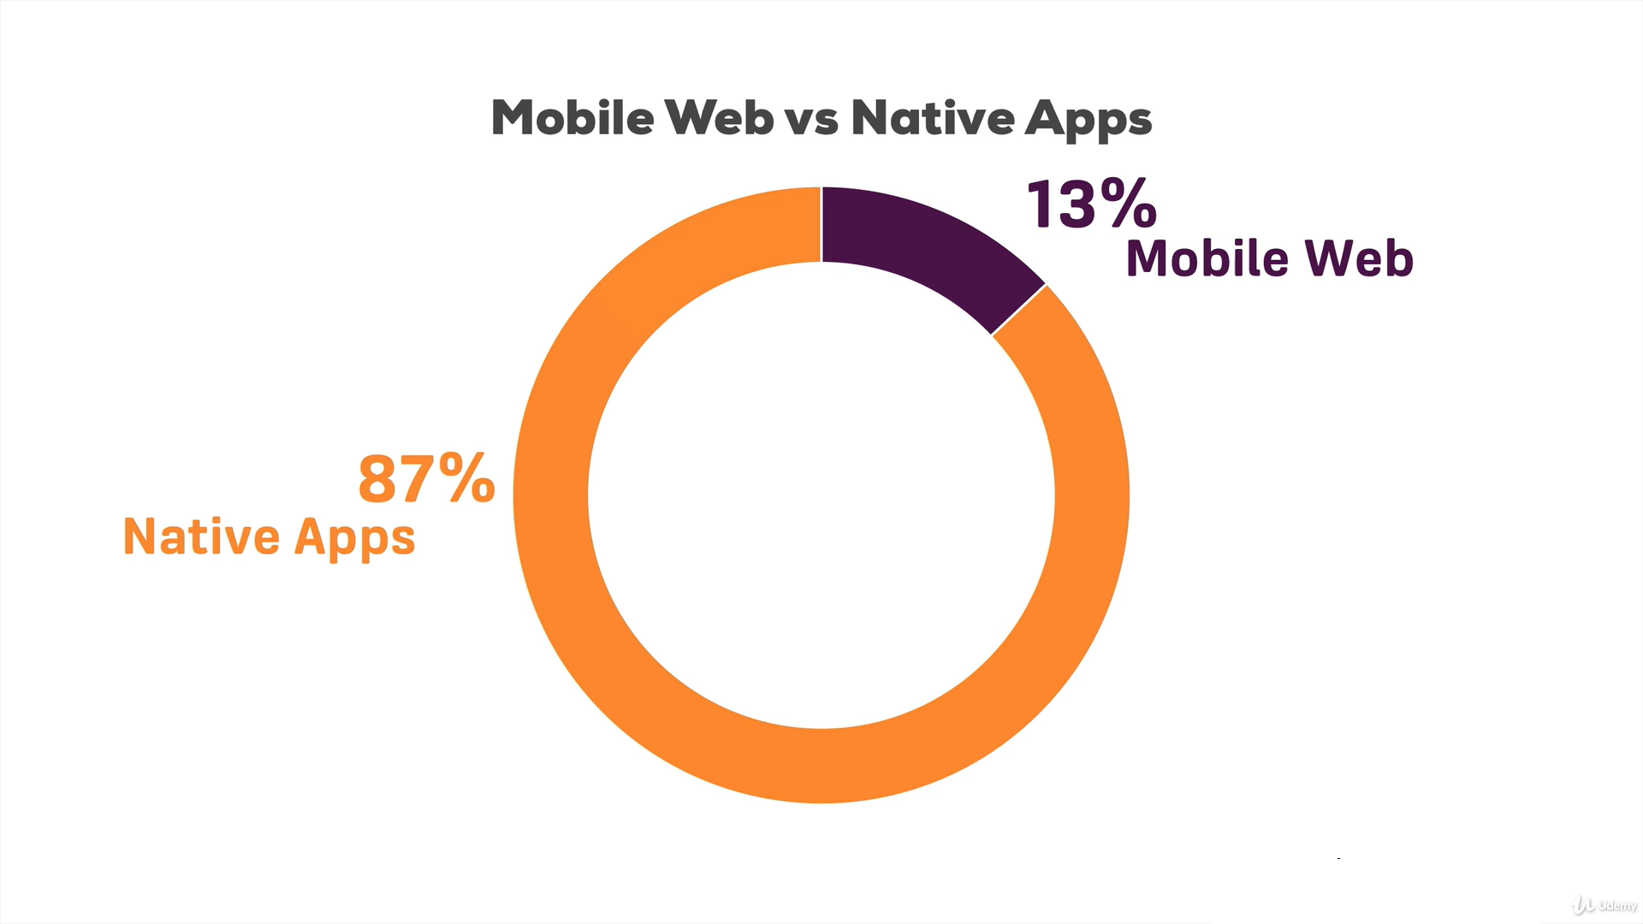
www.arkilos.com | enquiries@arkilos.com
Arkilos Inc. 2022 © All Rights Reserved

Slide 5
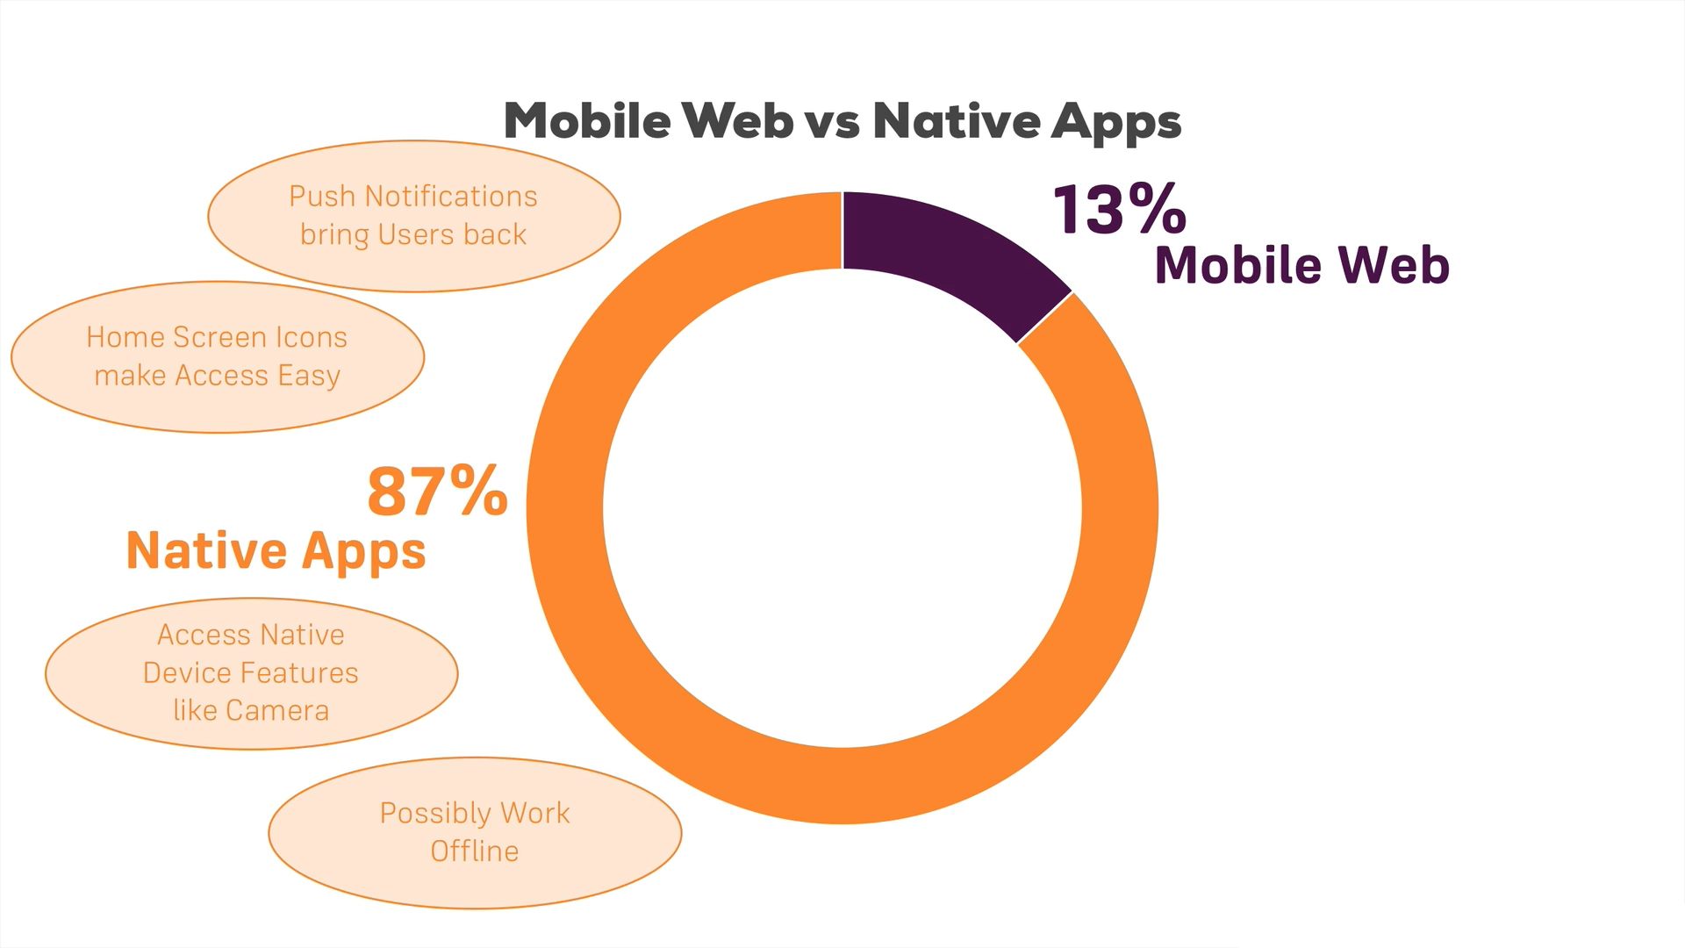
www.arkilos.com | enquiries@arkilos.com
Arkilos Inc. 2022 © All Rights Reserved

Slide 6
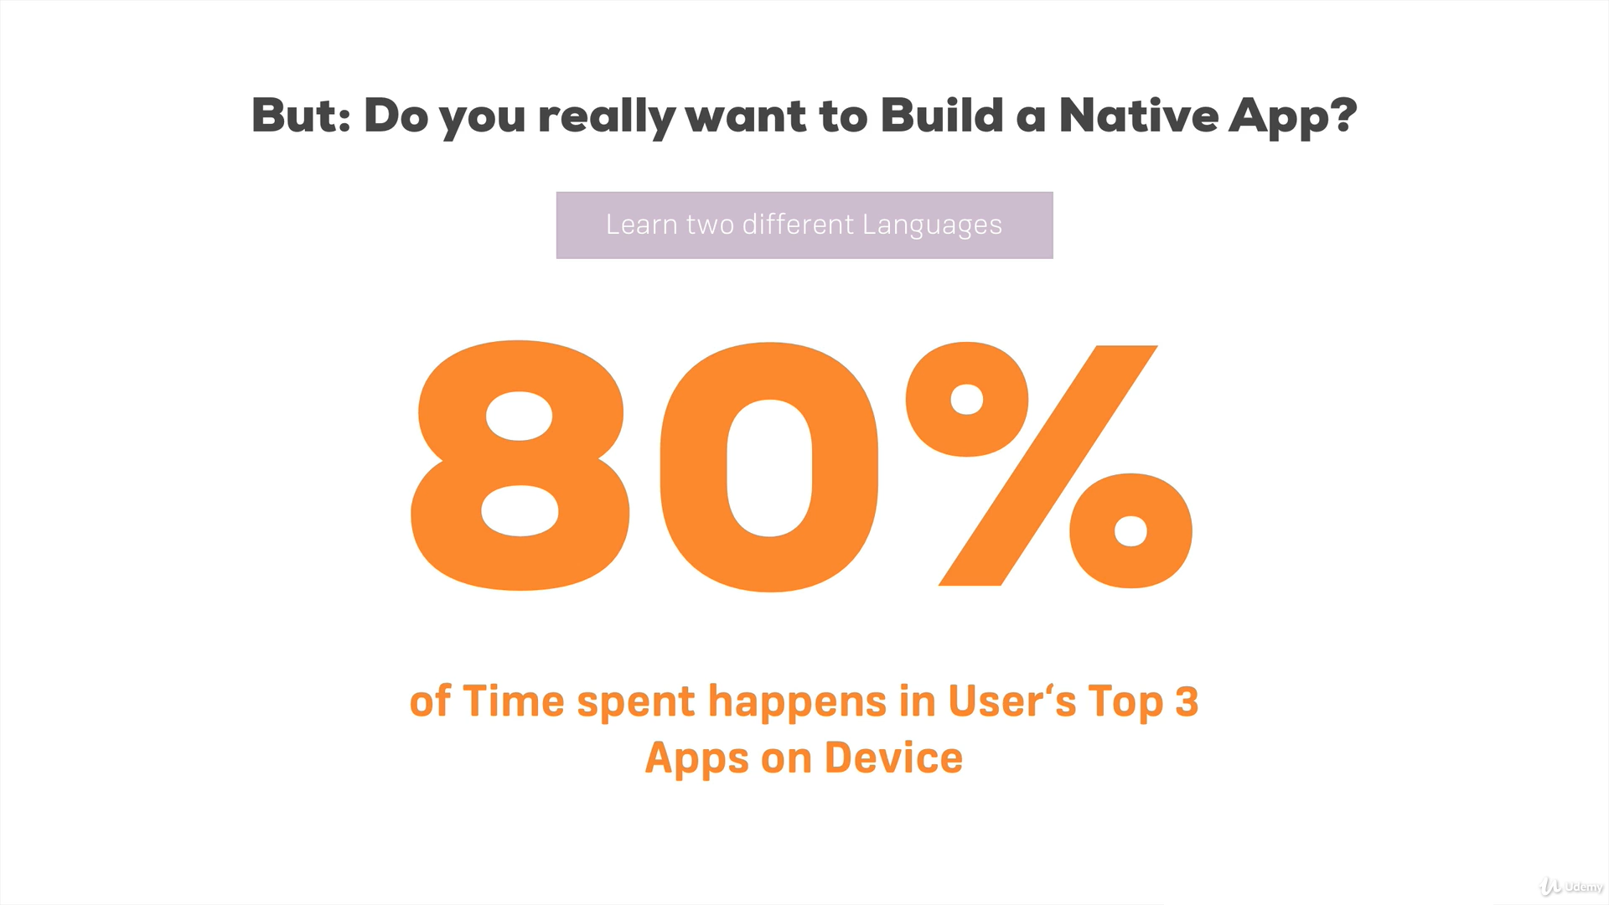
www.arkilos.com | enquiries@arkilos.com
Arkilos Inc. 2022 © All Rights Reserved

Slide 7
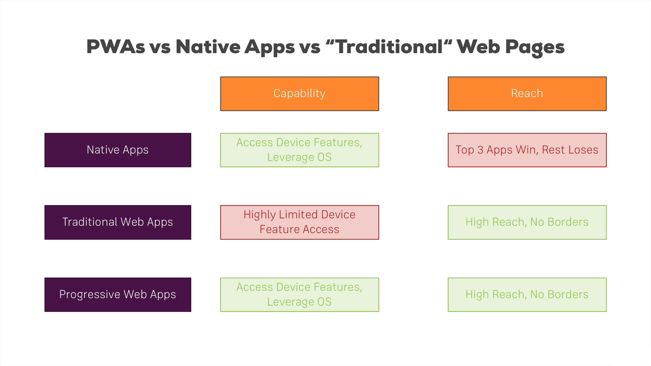
www.arkilos.com | enquiries@arkilos.com
Arkilos Inc. 2022 © All Rights Reserved

Slide 8
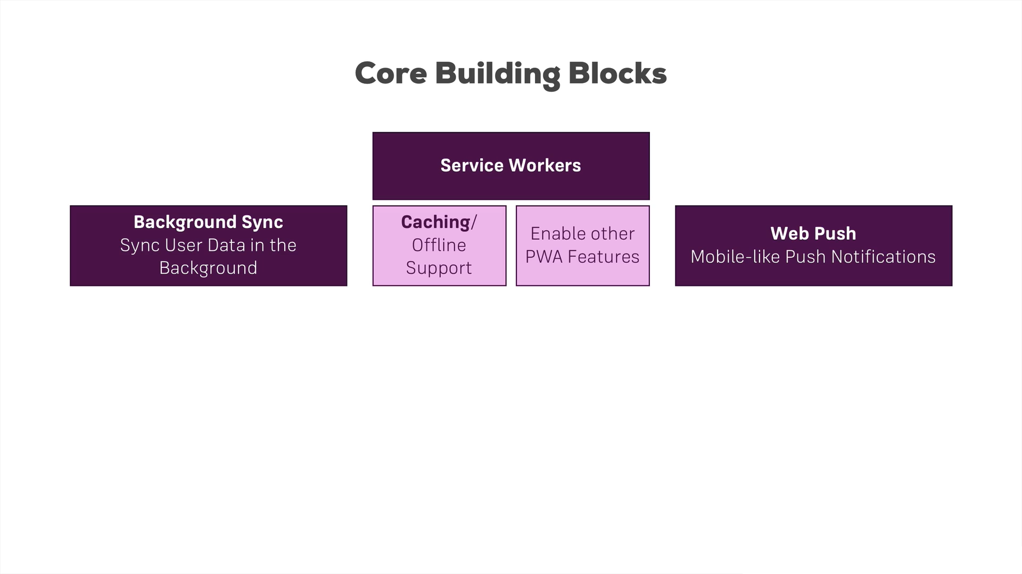
www.arkilos.com | enquiries@arkilos.com
Arkilos Inc. 2022 © All Rights Reserved

Slide 9
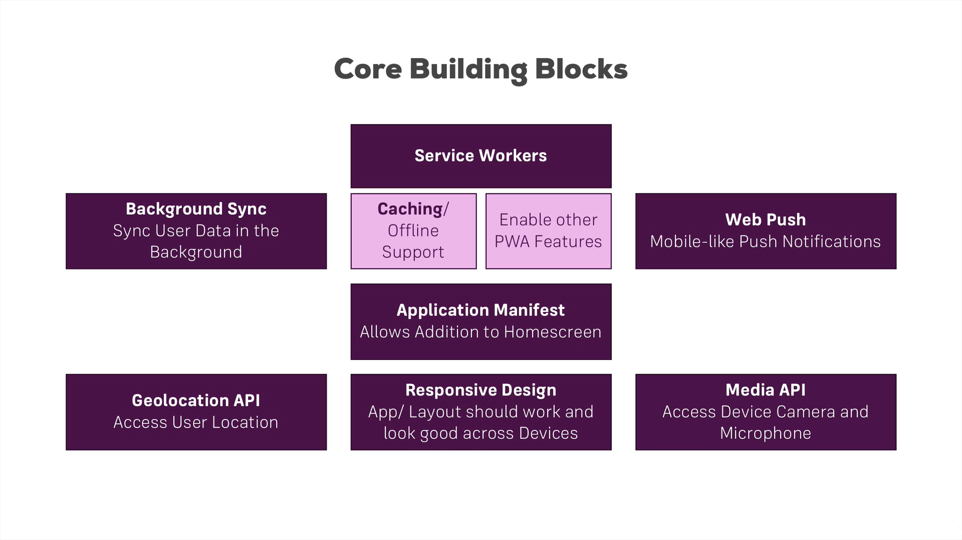
www.arkilos.com | enquiries@arkilos.com
Arkilos Inc. 2022 © All Rights Reserved

Slide 10
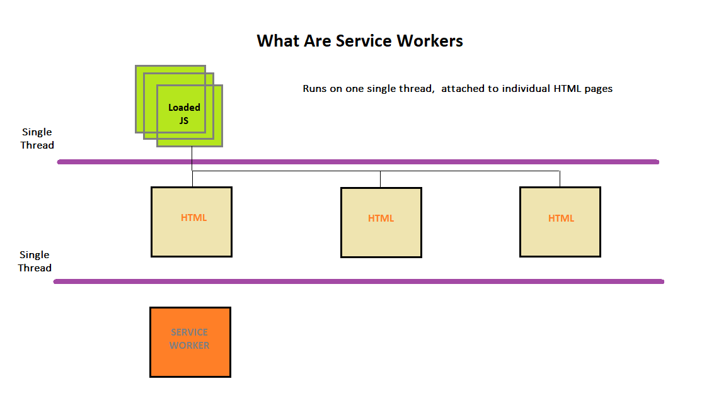
www.arkilos.com | enquiries@arkilos.com
Arkilos Inc. 2022 © All Rights Reserved

Slide 11
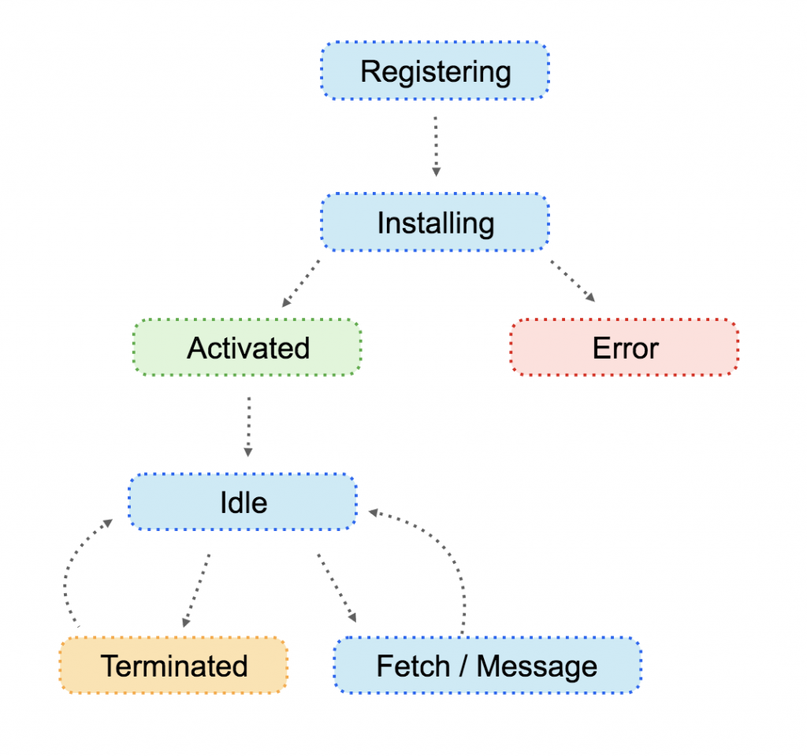
www.arkilos.com | enquiries@arkilos.com
Arkilos Inc. 2022 © All Rights Reserved

Slide 12
Benefits of PWA
Cross-platform Compatibility: PWAs work on various platforms and devices, including desktops, tablets, and mobile phones, reducing development efforts and ensuring a consistent user experience.
Offline Access: PWAs utilize service workers to cache data, allowing users to access content even without an internet connection, improving user satisfaction and engagement.
Fast Loading: With cached resources and optimized performance, PWAs load quickly, reducing bounce rates and increasing user retention.
Reduced Data Usage: PWAs consume less data compared to traditional web applications, benefiting users with limited data plans or slow internet connections.
App-Like Experience: PWAs offer a native app-like interface, providing a familiar and immersive user experience, without the need for app store installations.
Improved Discoverability: PWAs are discoverable by search engines, boosting SEO and increasing the likelihood of attracting organic traffic.
Seamless Updates: PWAs automatically update in the background, ensuring users always have the latest version without any manual intervention.
Secure and HTTPS-Enabled: PWAs require HTTPS, ensuring data privacy and security, promoting user trust in the application.
Lower Development and Maintenance Costs: By building a single PWA that works across platforms, development and maintenance efforts are streamlined, reducing overall costs.
Increased Engagement and Conversions: PWAs offer features like push notifications, enhancing user engagement and conversion rates by re-engaging users with personalized updates.
App Store Independence: PWAs can be distributed independently of app stores, avoiding approval processes and associated fees.
www.arkilos.com | enquiries@arkilos.com
Arkilos Inc. 2022 © All Rights Reserved

Slide 13

www.arkilos.com | enquiries@arkilos.com
Arkilos Inc. 2022 © All Rights Reserved

